Slide 1

Crimes Against Women: Exploratory & Descriptive Analysis
This analysis uncovers patterns, identifies high-risk regions, examines prevalent crime types, and explores long-term trends in gender-based violence across India, with emphasis on visualizing temporal changes, comparing crime volumes across states, and assessing the impact of specific types of violence.
by Yvette Niyogitangaza and Elyse uyiringiye

Slide 2
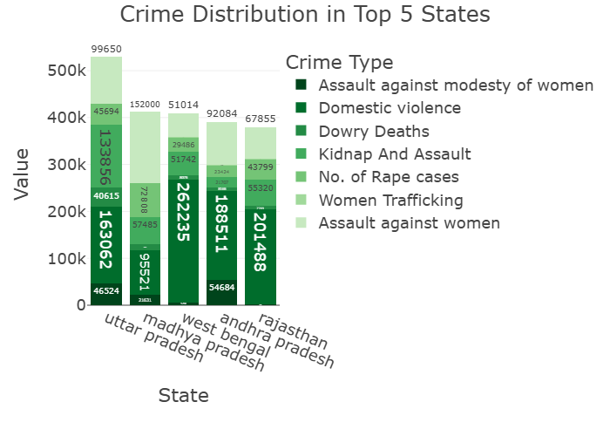
Top 5 States by Crime category
The data reveals significant disparities in crime reporting across Indian states:
1
2
3
Uttar Pradesh
West Bengal
Rajasthan
Lowest total crime count among the top 5 states
Highest total crime count with diverse crime types
Second highest in overall crime reporting

Slide 3
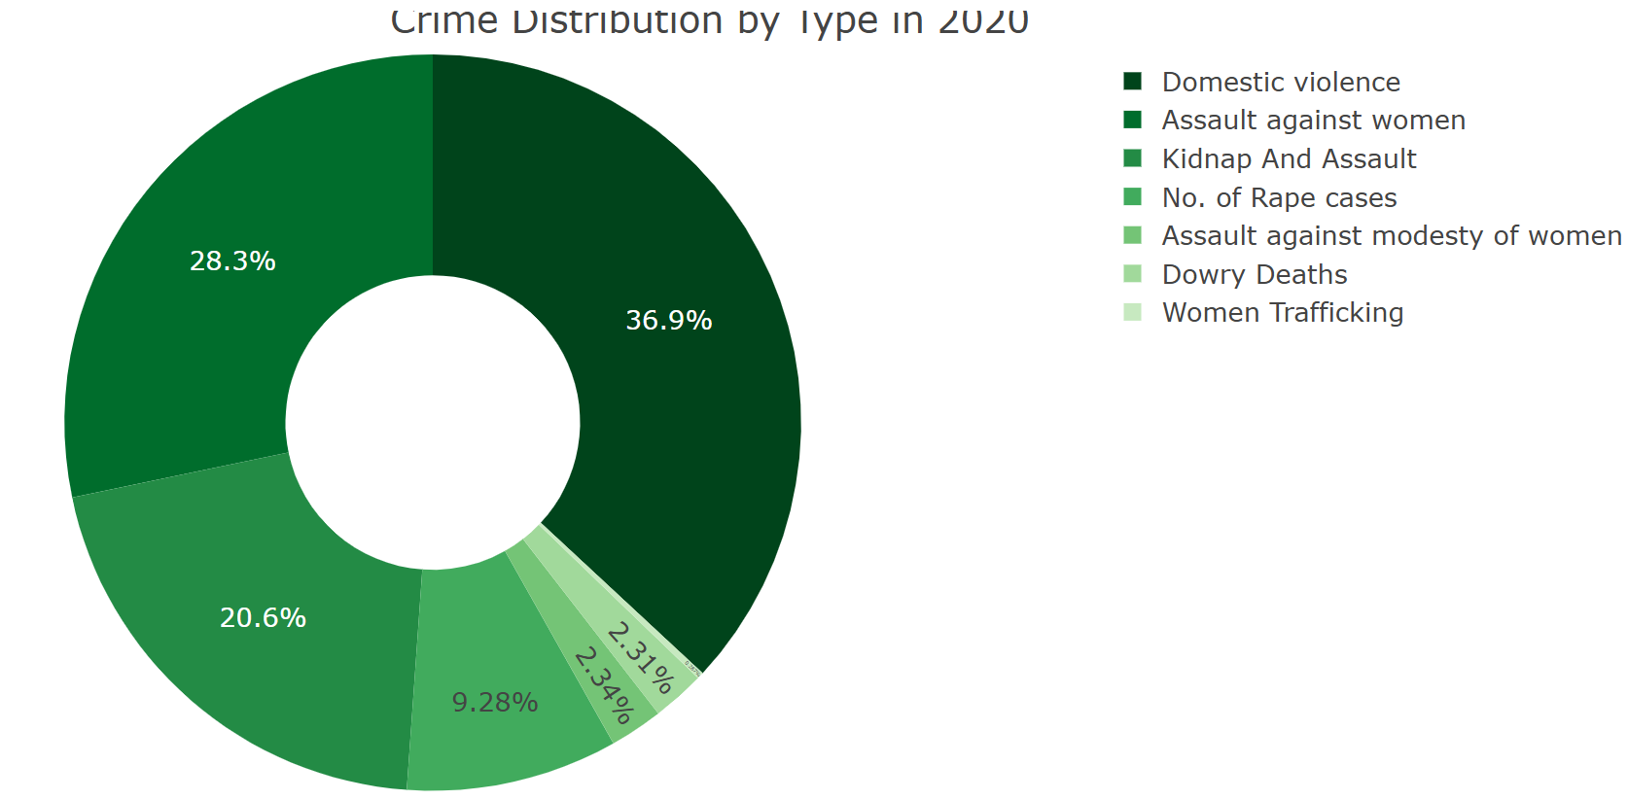
Pie Chart OF Crime Distribution by crime
- Each slice of the pie represents the count of a specific crime type.
- The largest slice corresponds to Domestic violence, which appears more frequently than other crimes.
- The smallest slice corresponds to women trafficking
- This visualization helps us better understand which crimes against women are most prevalent in the dataset.

Slide 4
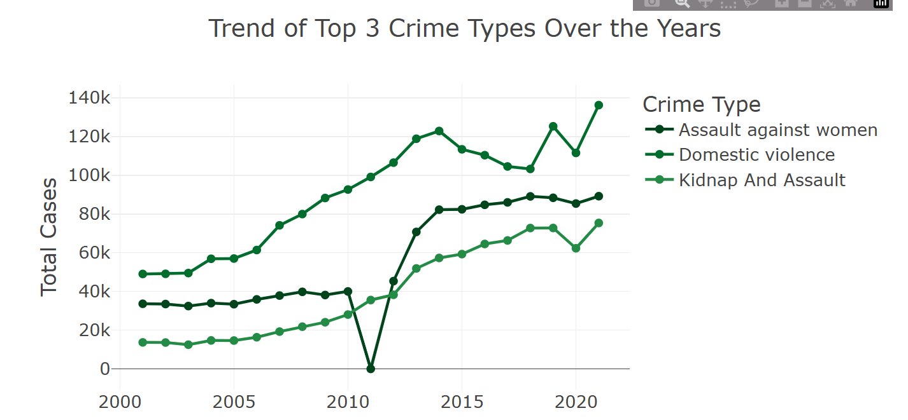



Top 3 Crime Trends
Domestic Violence
Shows consistent reporting with slight upward trend over years
Assault on Modesty
Demonstrates fluctuating pattern with periods of increase
Rape Cases
Shows statistically significant increasing trend (correlation = 0.13)

Slide 5
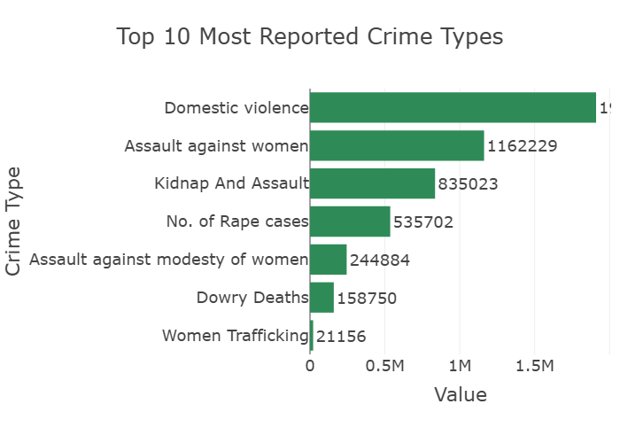
Top 10 Most Frequently Reported Crimes
This horizontal bar chart clearly identifies priority areas for policy intervention, awareness, and law enforcement efforts:
Domestic Violence ranks as the most frequently reported crime
The top 3 crimes account for over 50% of all reported cases
Women Trafficking, while less frequent, shows the strongest increasing trend over time

Slide 6
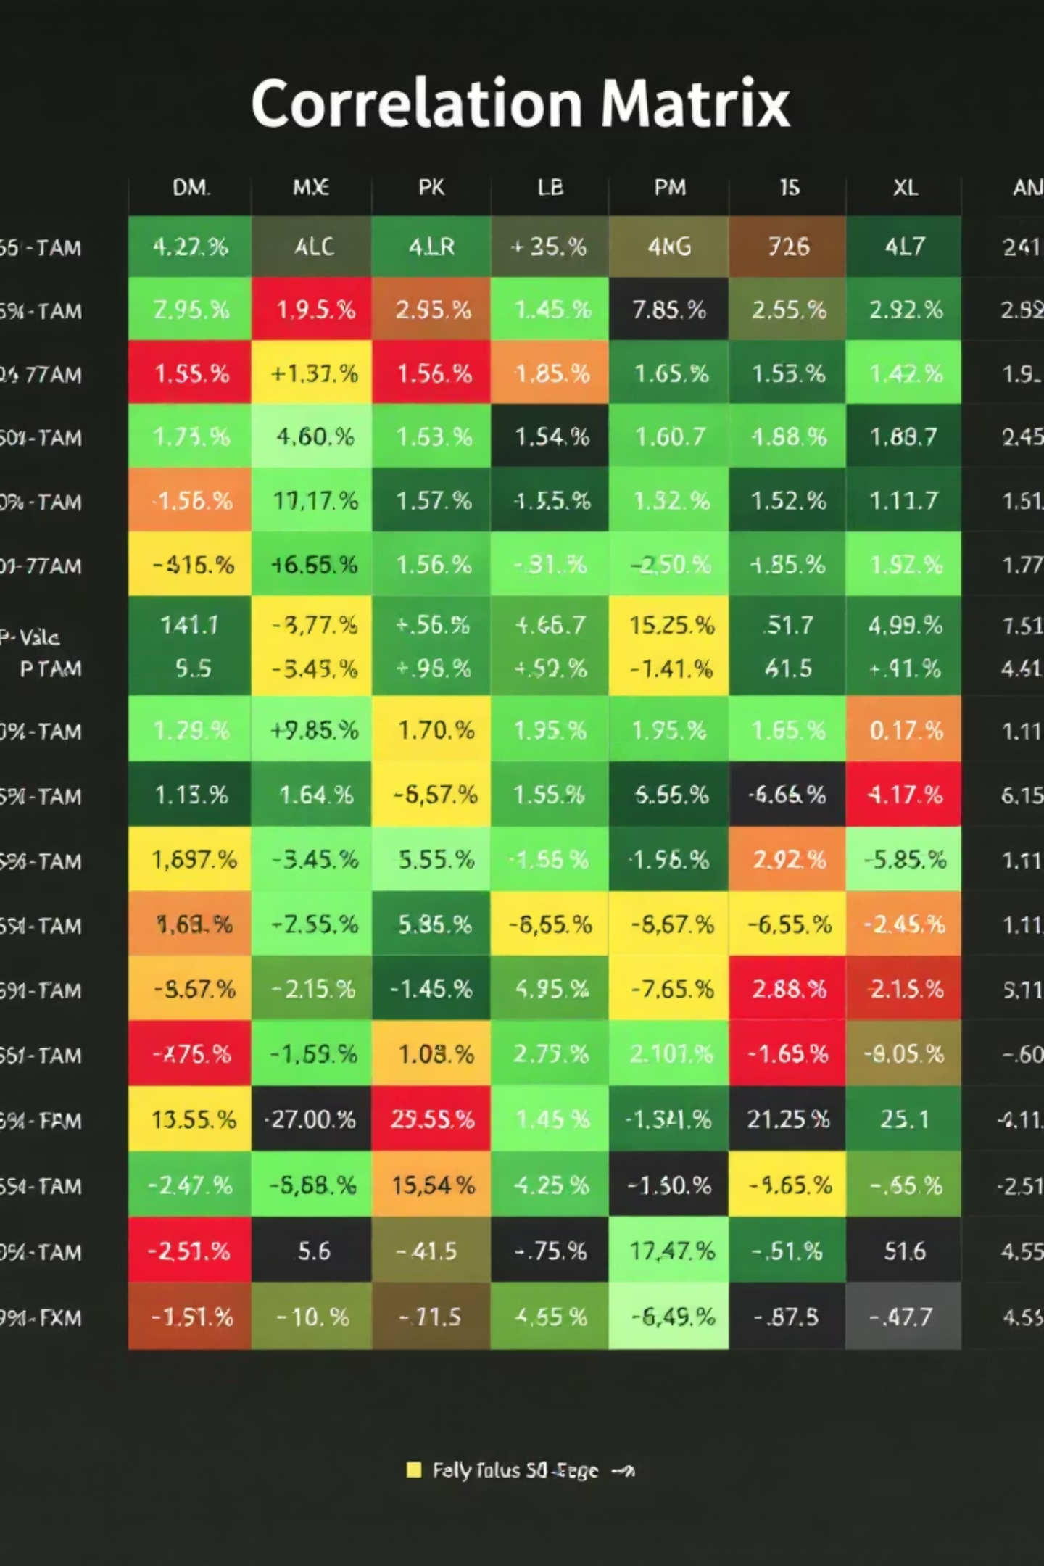
Statistical Testing Results
1
Chi-Square Test
Chi2 statistic = 1,039,977.76, p-value = 0.00000
Significant association between State and Crime Type (reject null hypothesis)
2
Spearman Correlation
Women Trafficking shows strongest increasing trend (correlation = 0.45)
Kidnap and Assault shows second strongest trend (correlation = 0.20)
Dowry Deaths shows no significant trend over years

Slide 7

Key Findings & Recommendations
Further Research
Address Rising Trends
Consider socio-economic factors for deeper correlations and use regression or time series analysis for forecasting trends.
Target High-Risk States
Women Trafficking shows the strongest increasing trend (correlation = 0.45), requiring urgent attention despite lower overall numbers.
Crime distribution varies significantly by state. Focus interventions on Uttar Pradesh and other high-crime regions.

